Slide 1
IoT based Automated Irrigation System & Mobile App for Tea Garden
PRESENTED BY:
Shariar Hasan
ID: 18701012
Session: 2017-2018
Computer Science & Engineering
University of Chittagong
SUPERVISED BY:
Dr. Mohammad Sanaullah Chowdhury
Professor
Computer Science & Engineering
University of Chittagong

Slide 2
Outline
Problem Statement
Motivation & Objective
Related Work
Limitations
Methodology
Experiment & Evaluation
Conclution & Future Work

Slide 3
Problem Statement
Ground Water Level Decreasing
Agricultural Land Area Decreasing
Agricultural Land Area Decreasing
Population & Food Demand Increasing
Waste of Water increasing

Slide 4
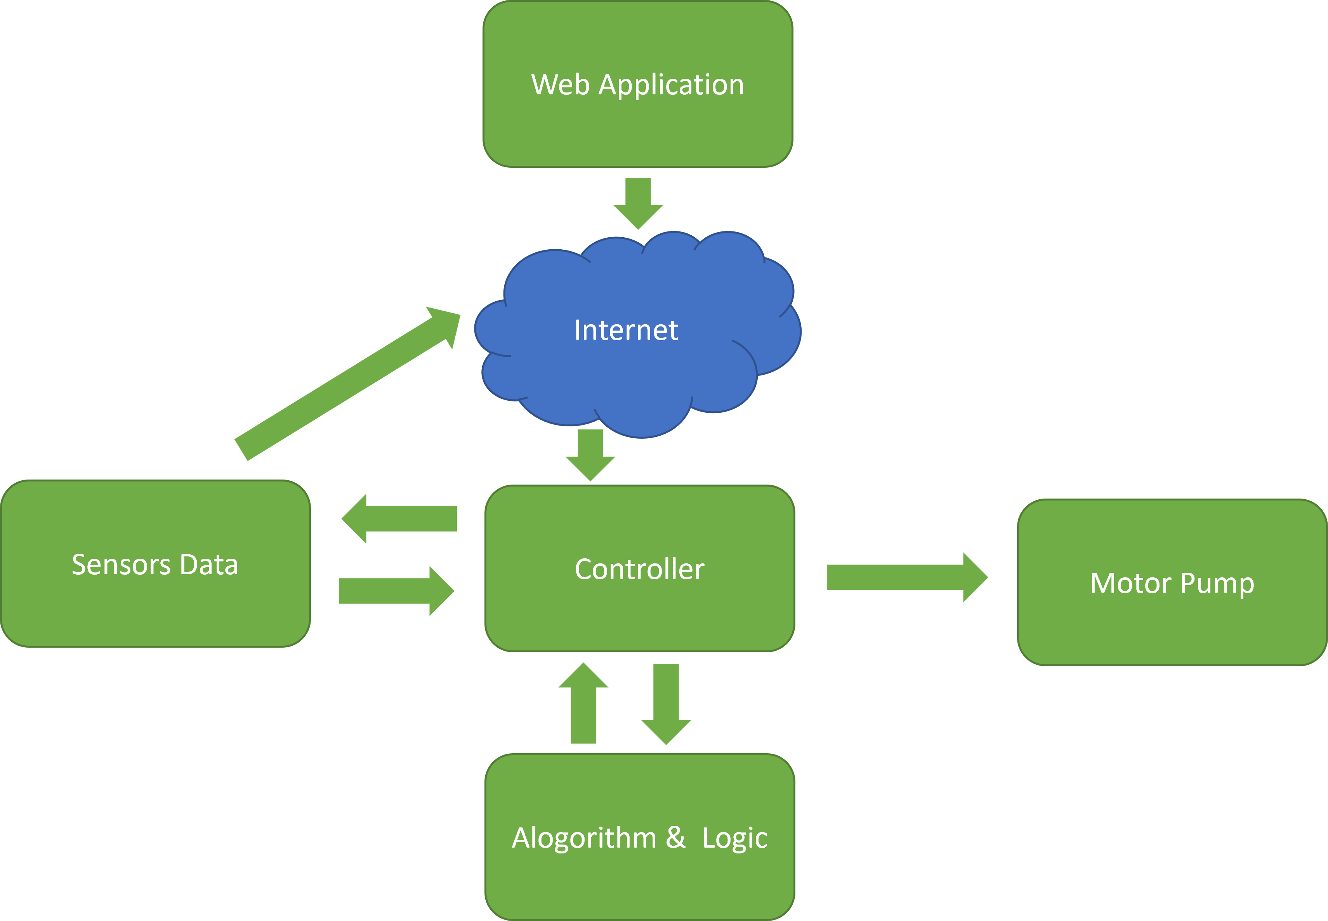
Problem Statement

Slide 5
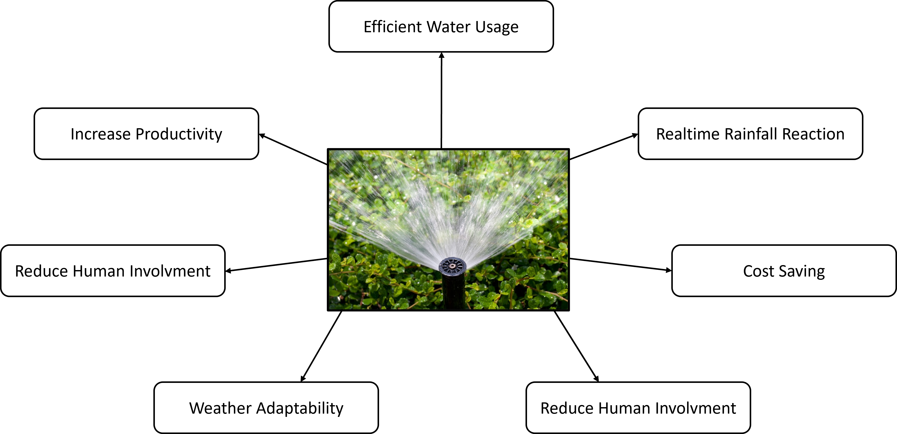
Motivation & Objective
Motivation:

Slide 6
Motivation & Objective
Objective:
To develop IoT based Irrigation System in Tea Garden
Analysis of Irrigation Data using IoT
To Increase monitoring efficiency in irrigation
To Reduce Workload in agriculture
To ensure lesser effort and greater profit

Slide 7
Related Work
Iot based smart crop-field monitoring and automation irrigation system by R. N. R. a. B. Sridhar in 2nd International Conference on Inventive Systems and Control, 2018.
IoT based smart irrigation system by S. Rawal in International Journal of Computer Applications, 2017.
Intelligent irrigation system an IoT based approach by S. A. a. V. V. K. M. N. Rajkumar in International Conference on Innovations in Green Energy and Healthcare Technologies, 2017.

Slide 8
Limitations
One Time Cost
24/7 Power Supply
Do not Predict rain, only check rain status.

Slide 9
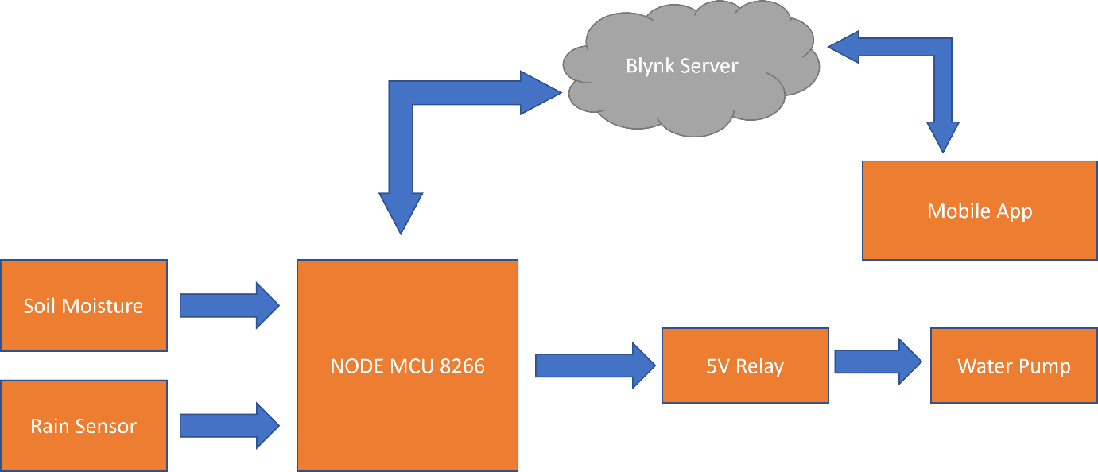
Methodology

Slide 10
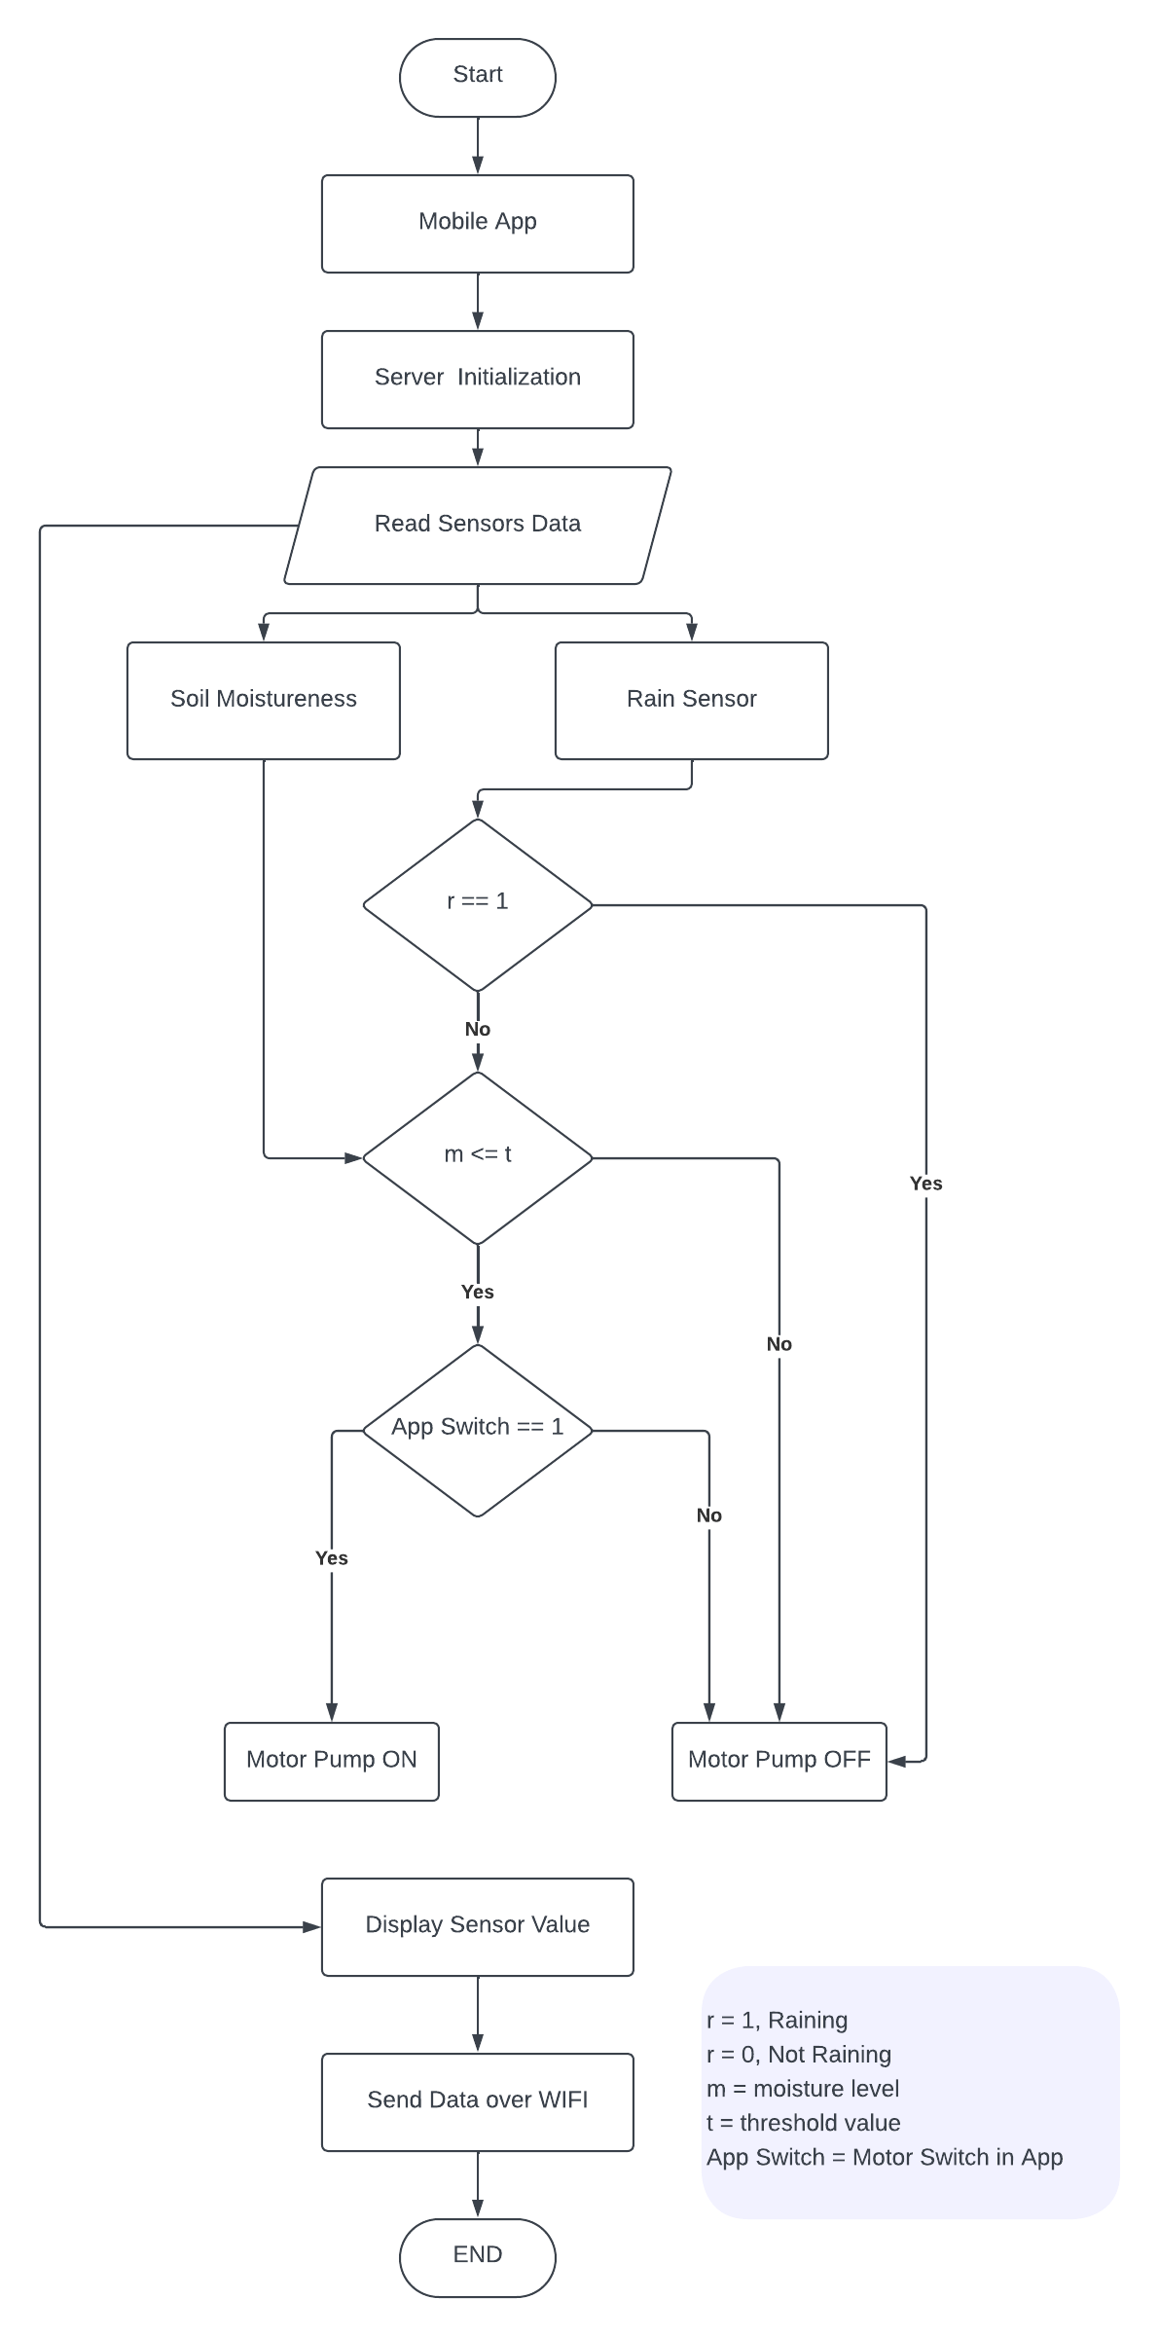
Methodology
NodeMCU runs program in Arduino code
Soil Sensor and Rain Sensor sense and send data to server
Server Returns the decision for motor to be ON or OFF

Slide 11
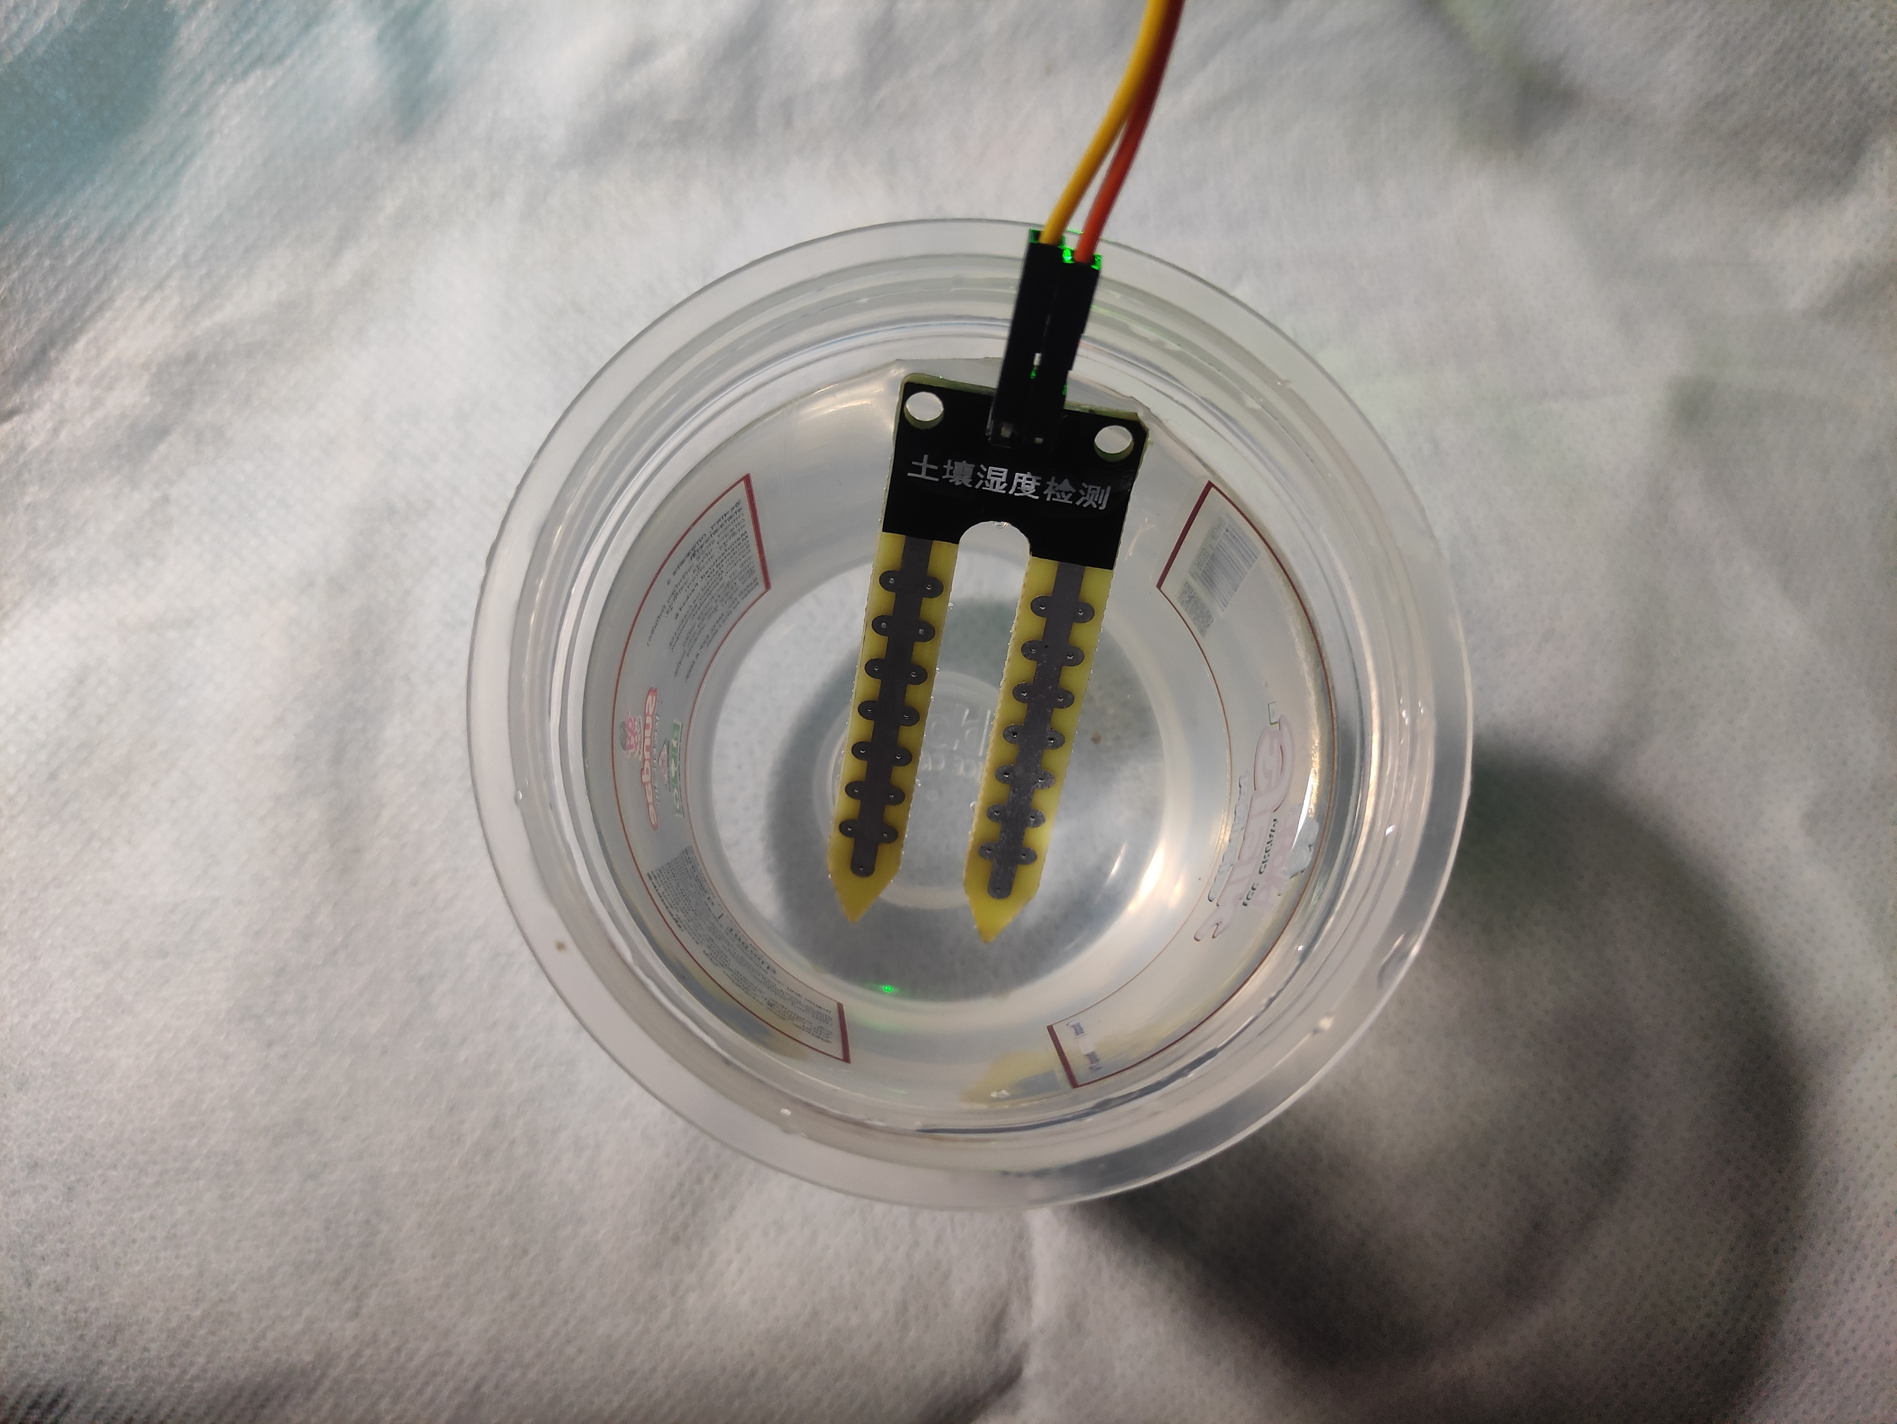
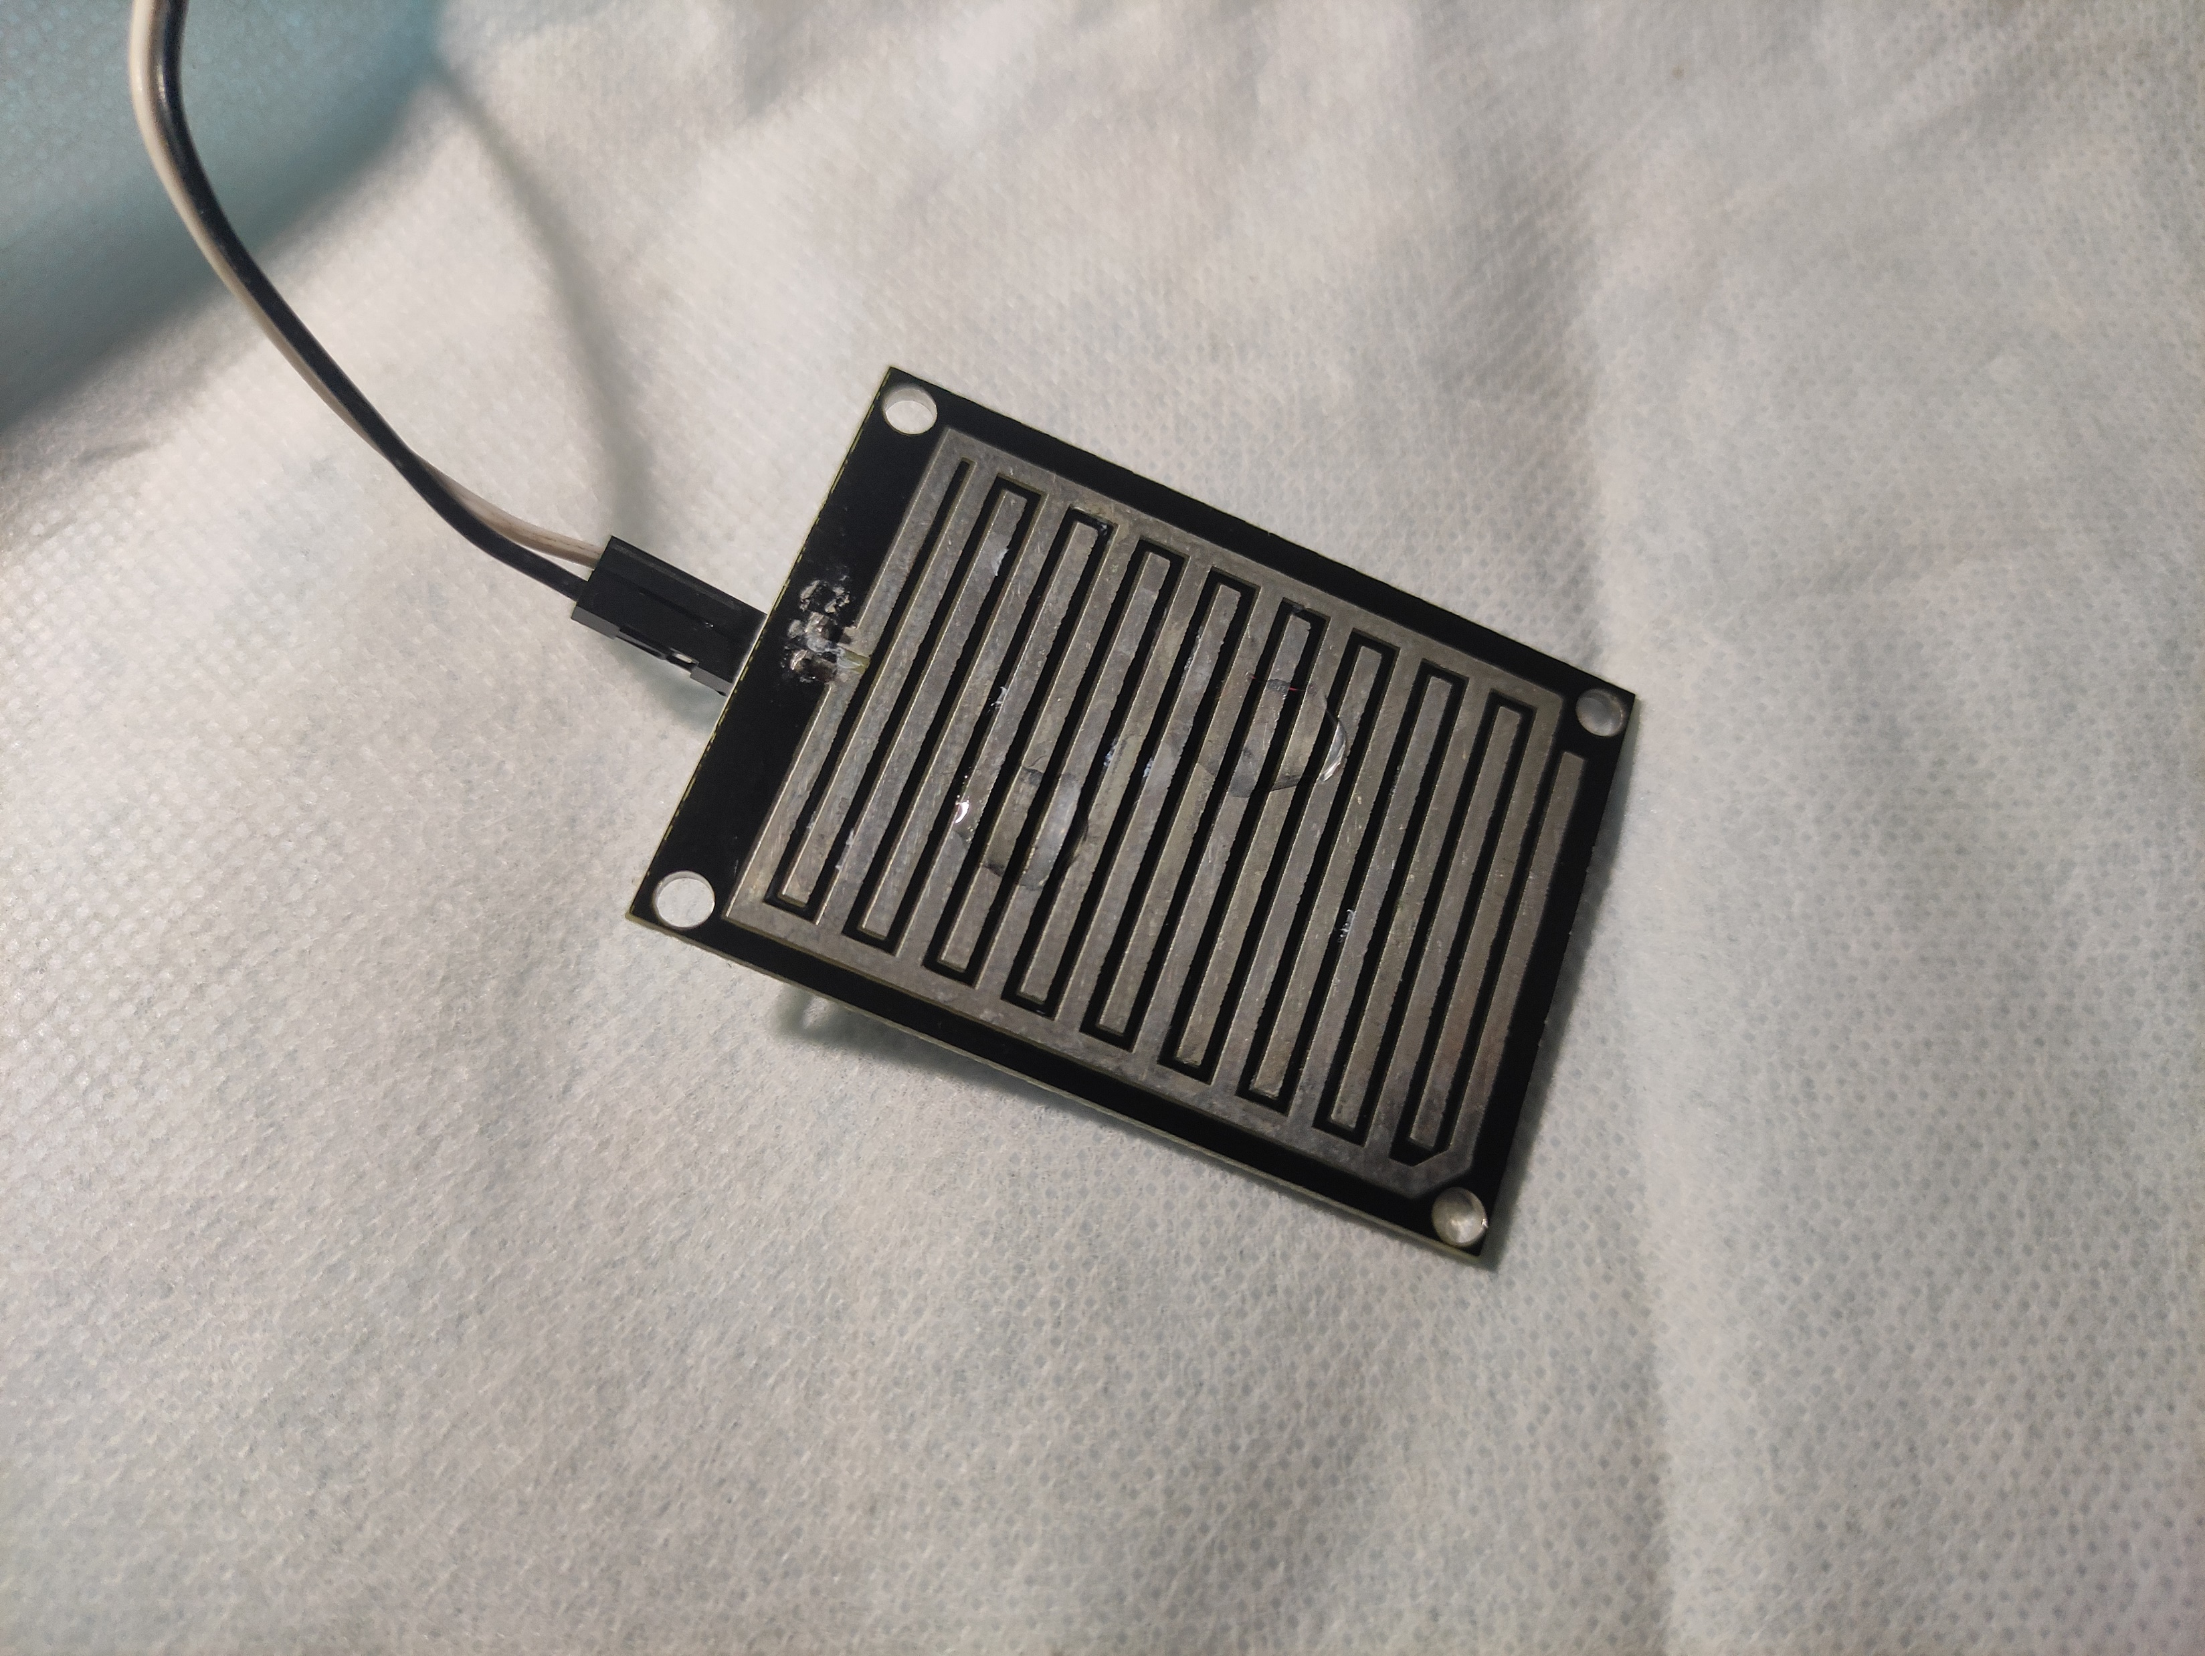
Experiment & Evaluation

Slide 12
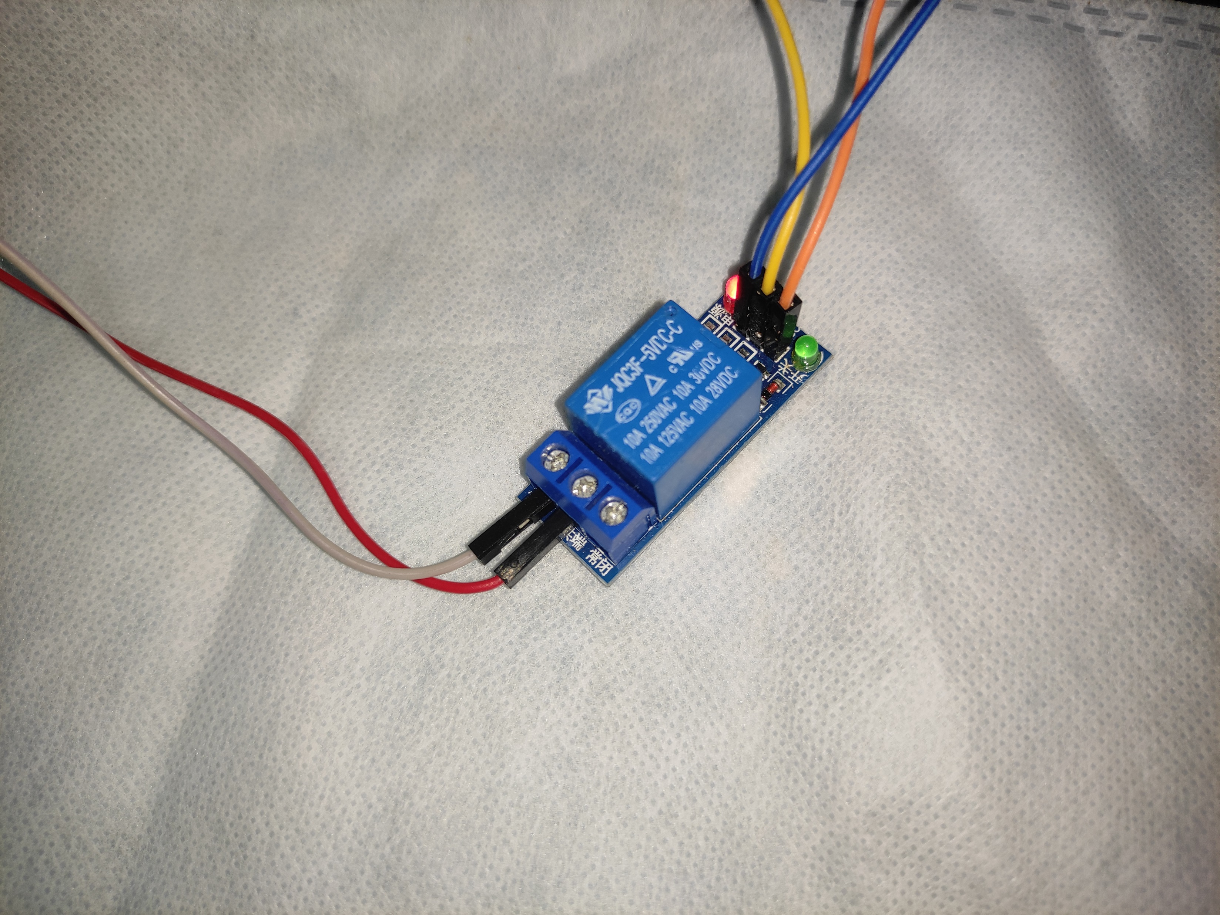
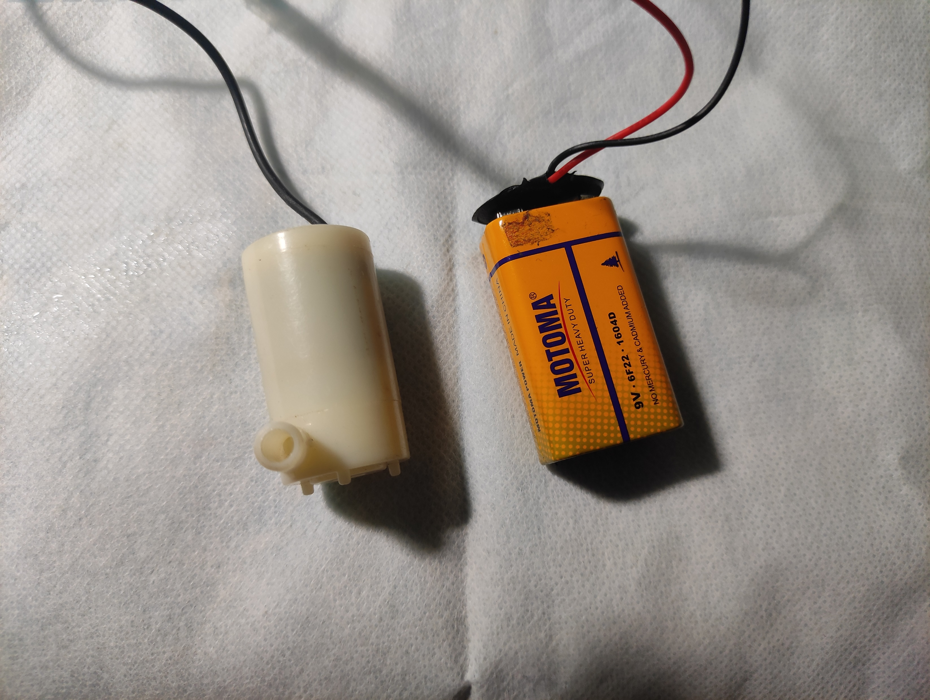
Experiment & Evaluation

Slide 13
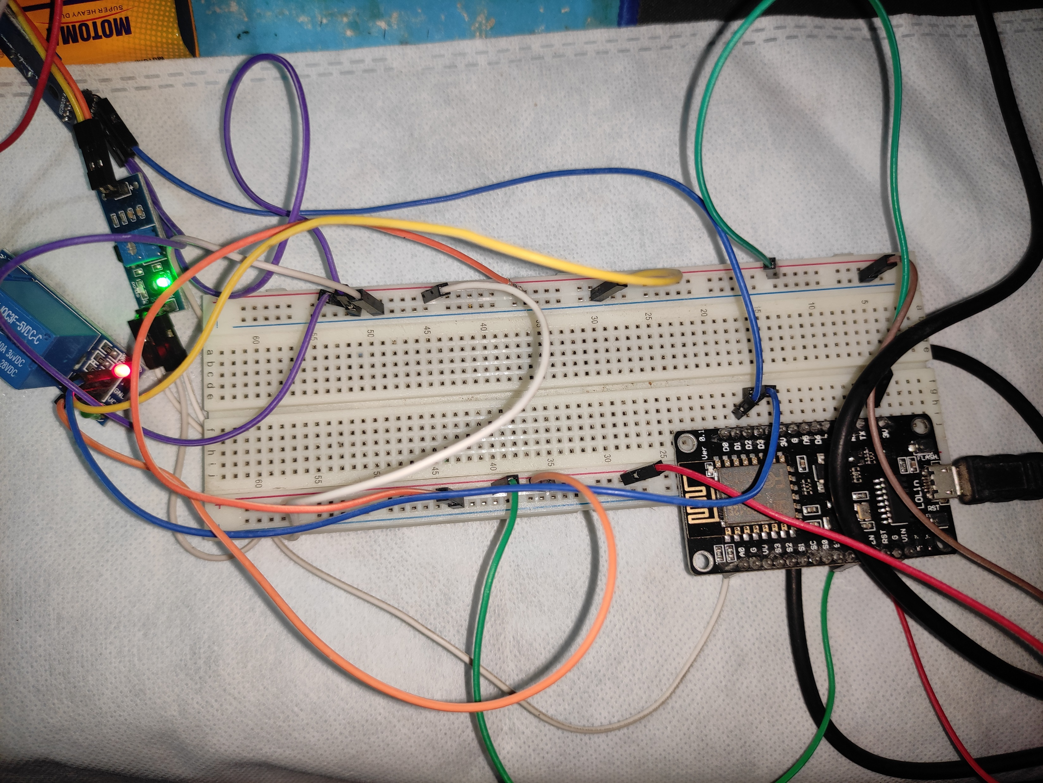
Experiment & Evaluation

Slide 14
Conclusion & Future Work
Conclution:
The System will reduce the traditional workload of irrigation and automates the whole irrigation system.
Connect the agriculture with the huge sector of IoT.
Future Work:
Machine Learning will be included in the system
Other sensor will also be included

Slide 15
THANK YOU

